Slide 1
CCPS530 Web Systems Development Course Project
IP GeoLocation
Trixie Xu

Slide 2
Project Requirements
Website that performs reverse lookup location using IP address
Support a basic level of security for user access (Login Function)
Use IPFind to request an IP address and output langitude/longitude
Use Leaflet to display map of IP address location with IP address input from IPFind

Slide 3
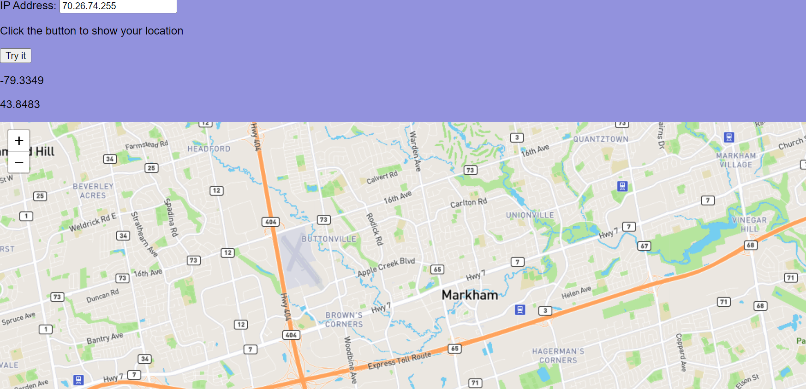

Slide 4
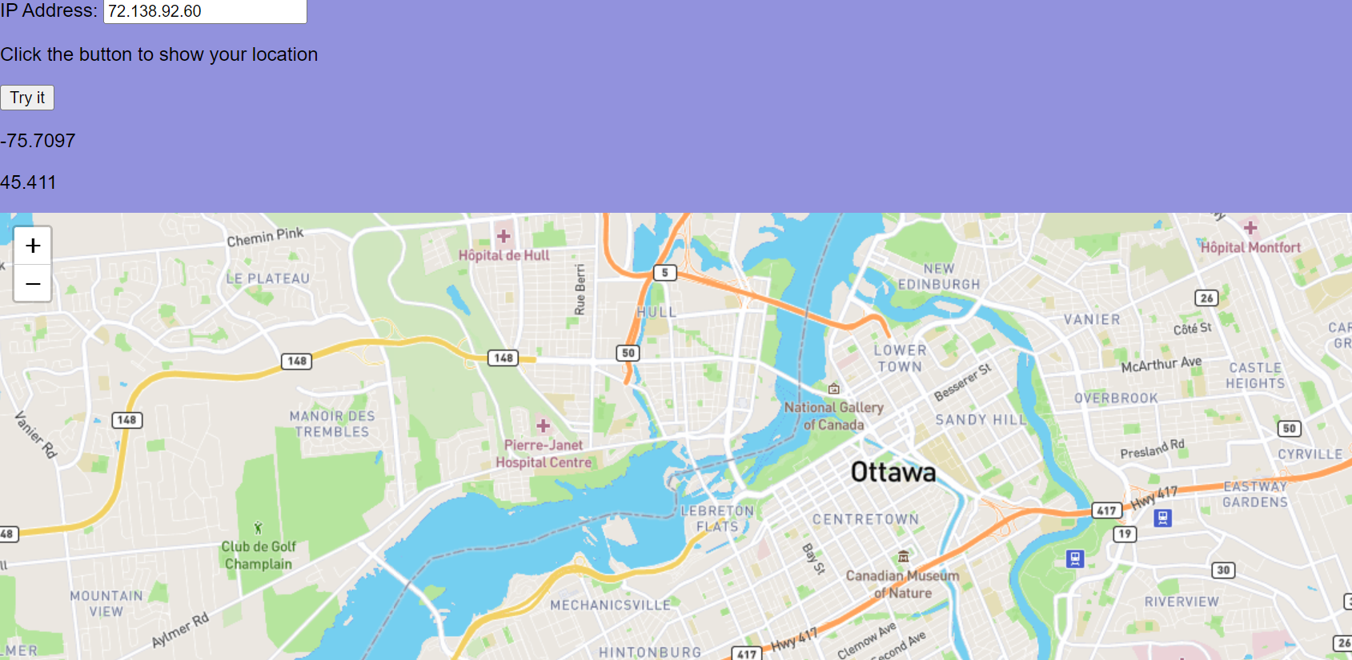

Slide 5
Challenges I Faced:
IPFind
Creating the Login System to work with the website
Putting it all together

Slide 6
Thank you for your time!

